Slide 1
A PROJECT PRESENTATION ON
“ADMINISTRATING AND IMPLEMENTING WINDOWS
SERVER 2016 IN AN AWS CLOUD INFRASTRUCTURE”
GUIDED BY: PRESENTED BY:
ZAKIR HUSSAIN RANI BEHARE
GAURI VETAL
SAKSHI SHAHA
DEEPANKER SAMANTHA
HARSHAL PATIL
RENUKA CHAVAN
PRAJWAL NIMKARDE

Slide 2
OUTLINE
Introduction
Objectives
Feasibility Study
Proposed System
A Detailed Walkthrough
Real-time Scenario
Conclusion
Future Scope

Slide 3
INTRODUCTION
In this project, we implemented a comprehensive cloud-based solution using AWS Cloud Infrastructure to host and manage a Windows Server 2016 environment.
The goal was to provide a secure, scalable, and resilient platform for various critical services such as identity management, network services, web hosting, and file storage.
Key features include the installation and configuration of Active Directory Domain Services (AD DS) for centralized user management, along with DNS, DHCP, and a web server for network and application hosting needs.

Slide 4
OBJECTIVES
To proficiently administer and implement Windows Server 2016 in an AWS cloud infrastructure by leveraging cloud-based tools and services for optimized performance, scalability, and security.
Ensure seamless integration of Windows Server with AWS services such as EC2, VPC, and IAM, enabling efficient server management, data backup, and recovery.
Focus on automating deployments, monitoring server performance, and enhancing security using AWS Identity and Access Management policies and AWS CloudWatch.

Slide 5
Prerequisites
SOFTWARE REQUIREMENTS:
For AWS EC2 Instance :
Operating System: Microsoft Windows Server 2016 Core
Windows Features:
- AD DS
- DNS Server
- File And Storage Services
- Web Server (IIS)
For Local Machine:
- Remote Desktop Client
- Web Browser

Slide 6
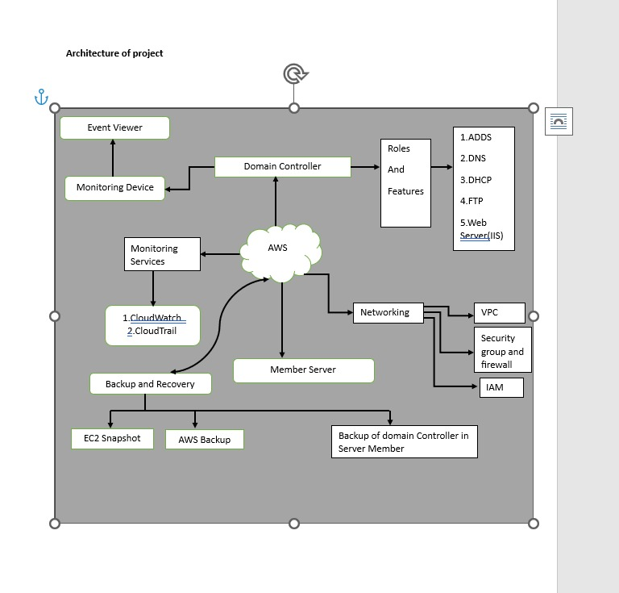
PROPOSED SYSTEM

Slide 7
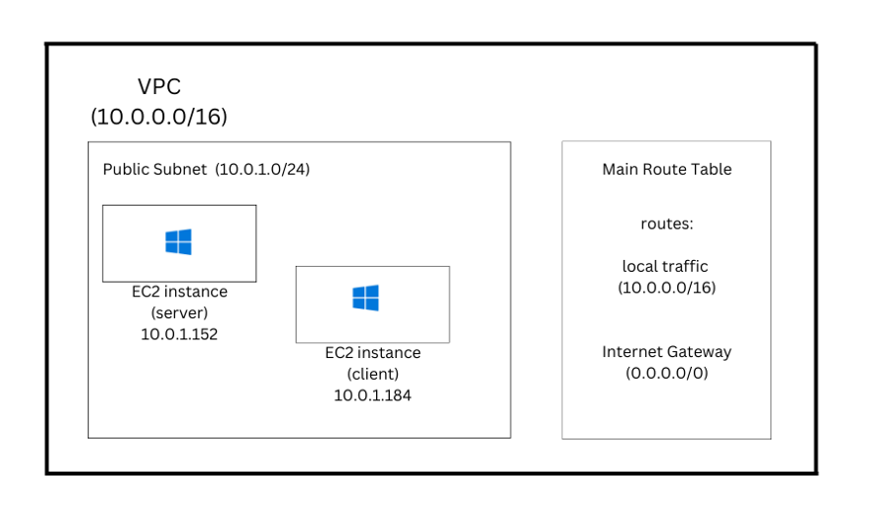
PROPOSED SYSTEM

Slide 8
AWS SERVICES USED
1. AWS Directory Service: AWS Directory Service is a managed service that helps you set up and run Microsoft Active Directory (AD) in the AWS Cloud. It provides different directory options to integrate and manage users, groups, and resources in a secure and scalable environment.
2. EC2 (Elastic Compute Cloud): EC2 instances form the core of the infrastructure where Windows Server 2016 is hosted. These virtual machines provide scalable compute resources necessary for deploying critical Windows Server services such as AD DS, DNS, DHCP, and web servers.
3. VPC (Virtual Private Cloud): A Virtual Private Cloud is used to create a secure, isolated environment for Windows Server deployment. Subnets are configured to segment the network into private and public zones, ensuring that sensitive resources are accessible only via controlled methods.

Slide 9
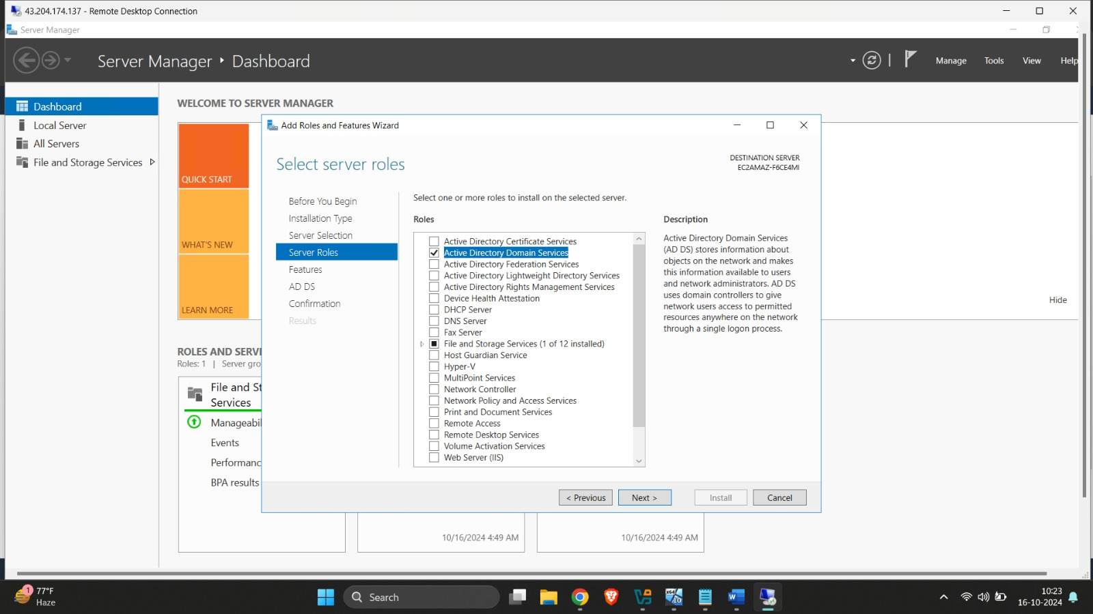
WINDOWS SERVER COMPONENTS INSTALLED
Active Directory Domain Services (AD DS): AD DS is set up on the Windows Server to manage user identities, groups, and access controls. It provides centralized user authentication and authorization services across the network.

Slide 10
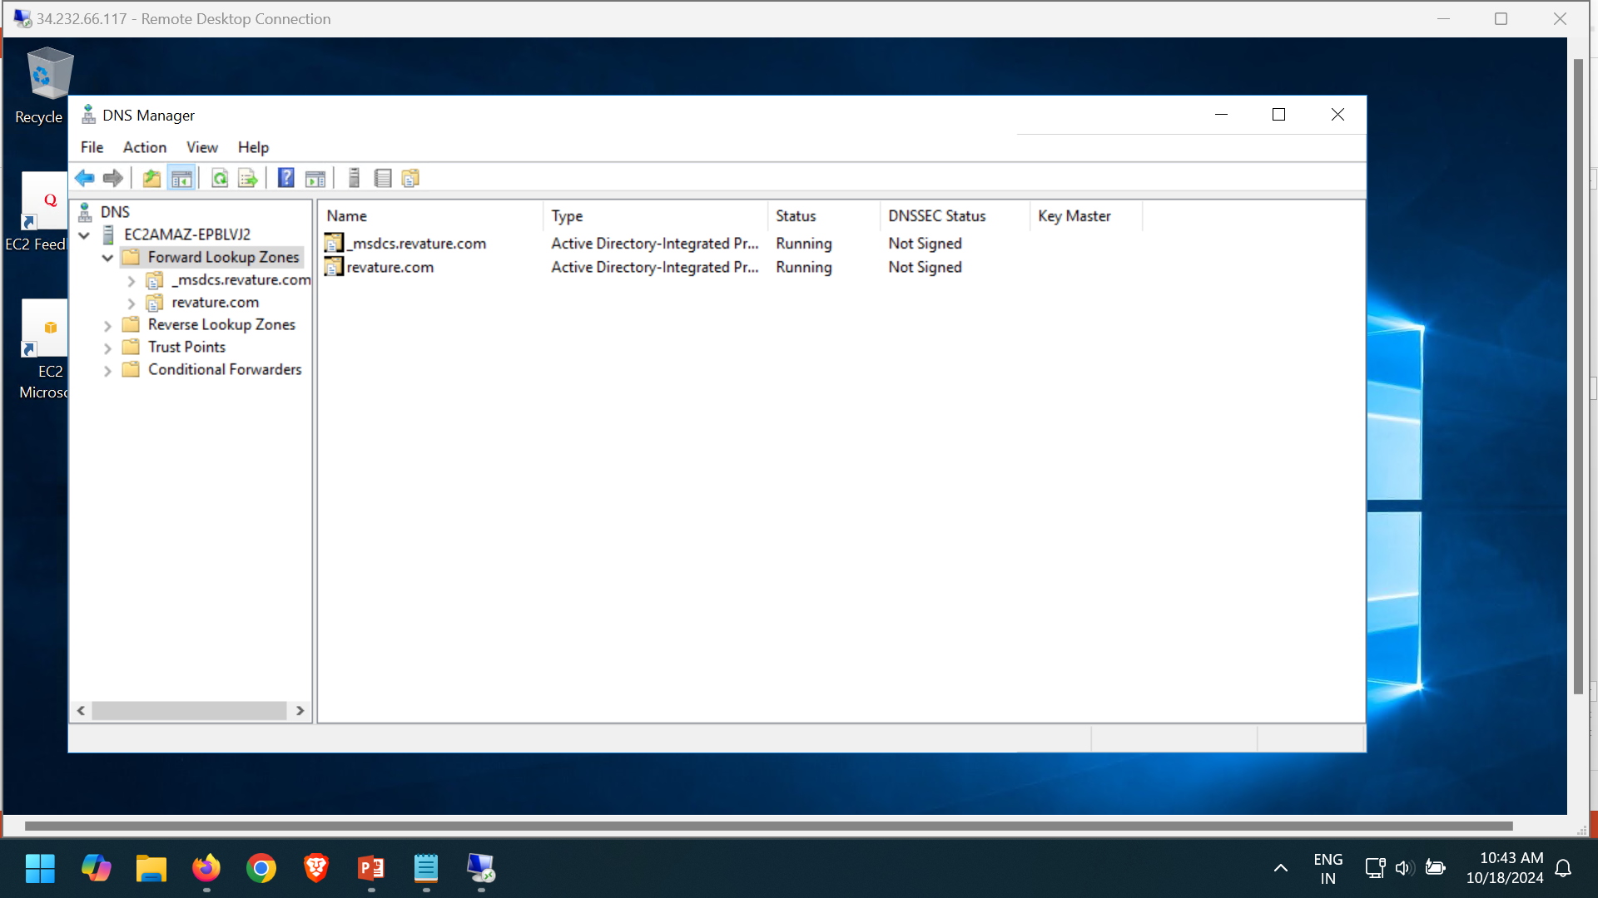
2. DNS (Domain Name System): DNS is deployed for resolving domain names to IP addresses within the network, essential for the functioning of AD DS and communication between networked systems.

Slide 11
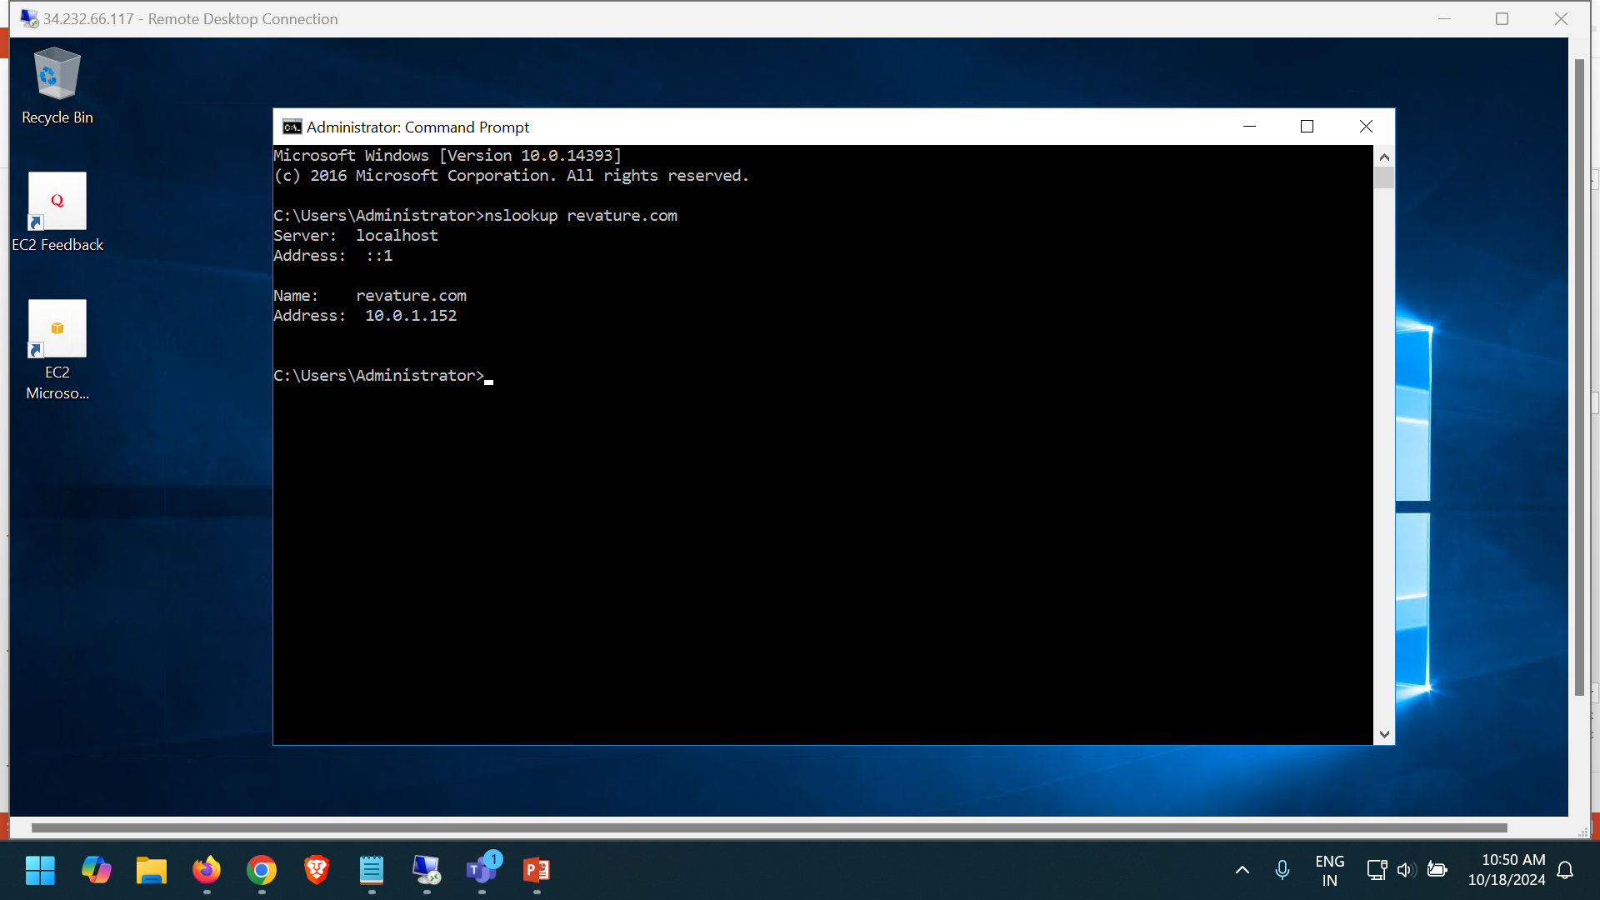

Slide 12
3.DHCP (Dynamic Host Configuration Protocol): When you launch an EC2 instance in a subnet within a VPC, the VPC allocates a private IP address to the instance. Each subnet is associated with a range of IP addresses (a CIDR block), and AWS selects an available private IP address from this range and assigns it to the instance. AWS VPC uses an internal DHCP (Dynamic Host Configuration Protocol) server to automatically assign private IP addresses to EC2 instances. 4.Web Server: IIS (Internet Information Services) is installed to host and manage websites and web applications on the server. It allows secure access to hosted applications via public-facing EC2 instances. The Web Server Home page files are created in C:\inetpub\wwwroot folder, the administrator can change the website according to the requirement

Slide 13
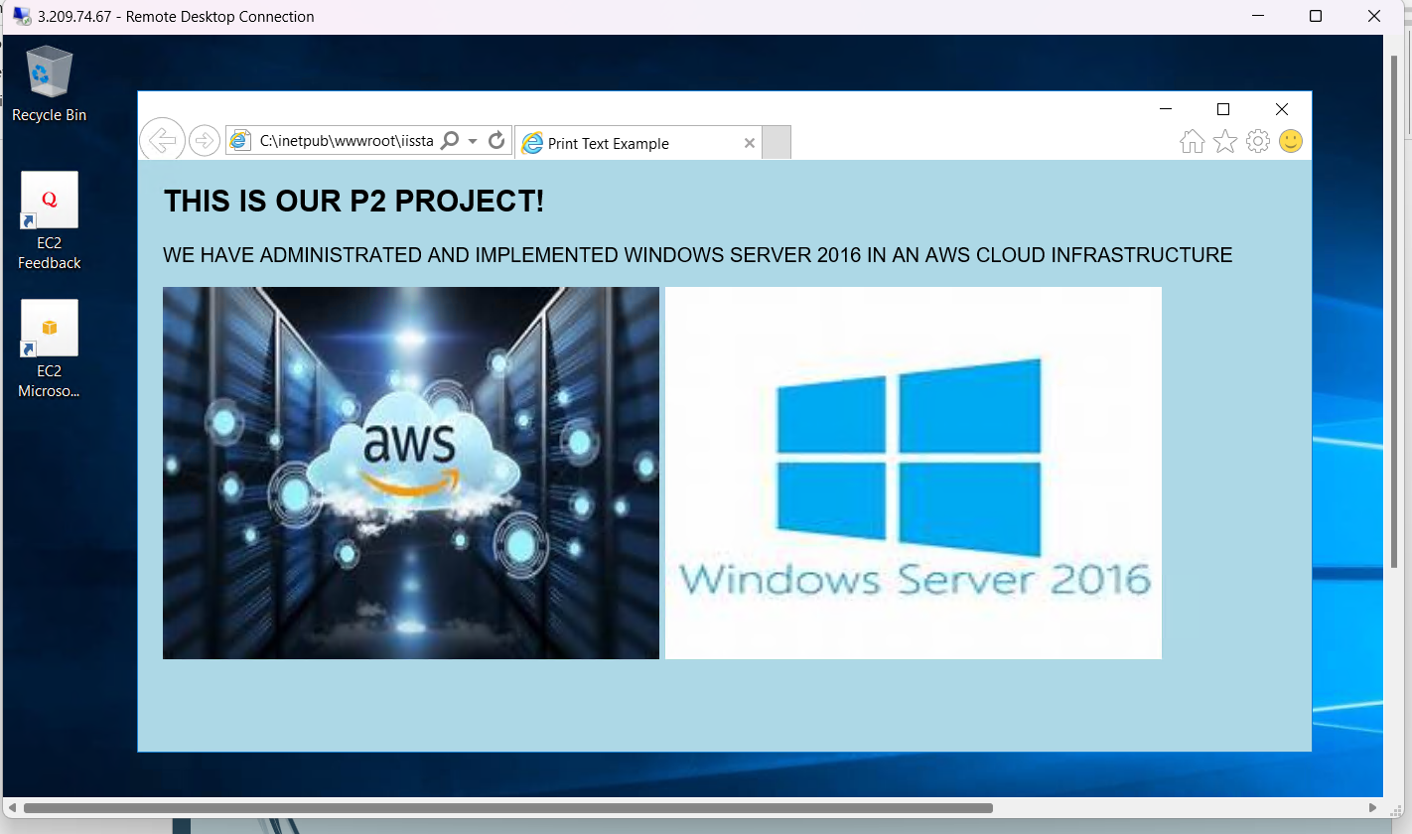

Slide 14
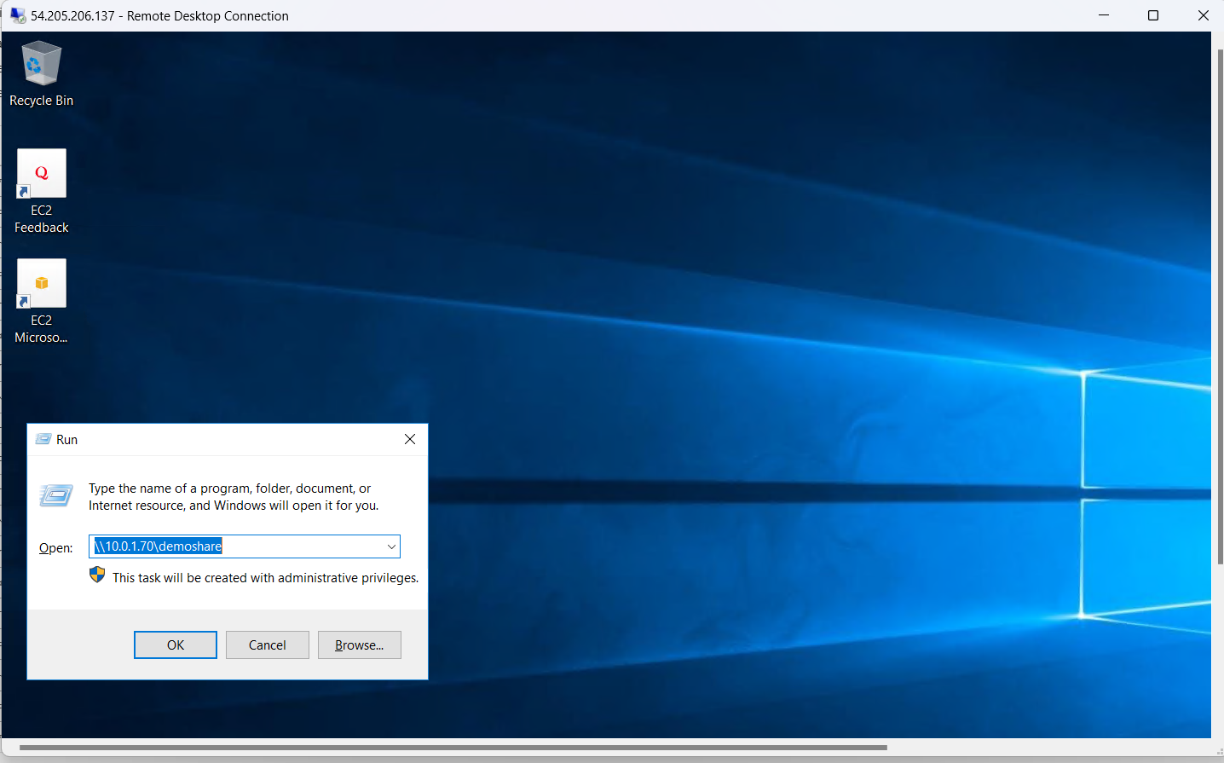
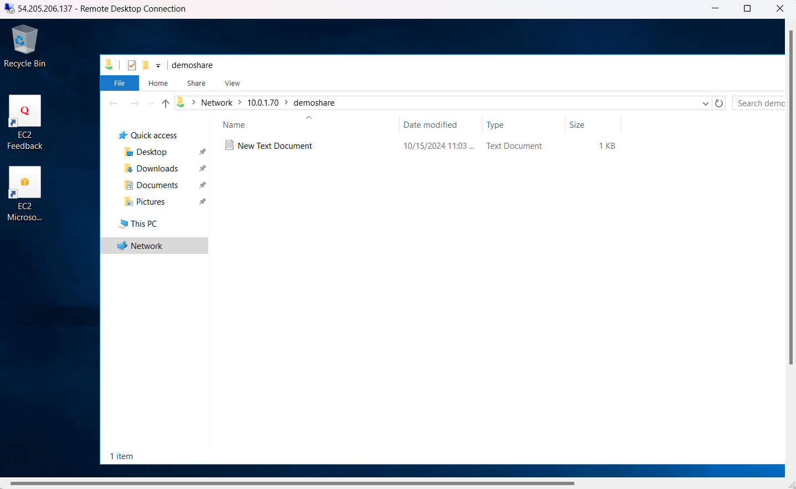
5. File and Storage Service : File and Storage Services in Microsoft Windows Server 2016 provide tools and features for managing data, sharing files, and ensuring data availability. These services are critical for file storage management, and they include a variety of tools for file sharing, data replication, and storage space management. You can access the shared folder by using the private IP of the Server where the folder is created.

Slide 15
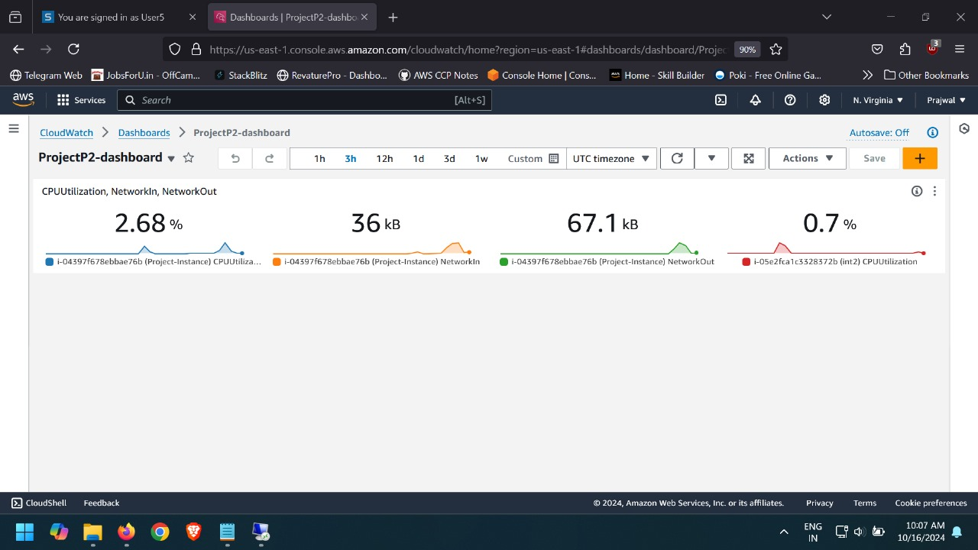
MONITORING
CloudWatch: AWS CloudWatch is used to monitor the performance of EC2 instances and other AWS resources. It tracks CPU utilization, memory usage, disk activity, and other performance metrics.

Slide 16
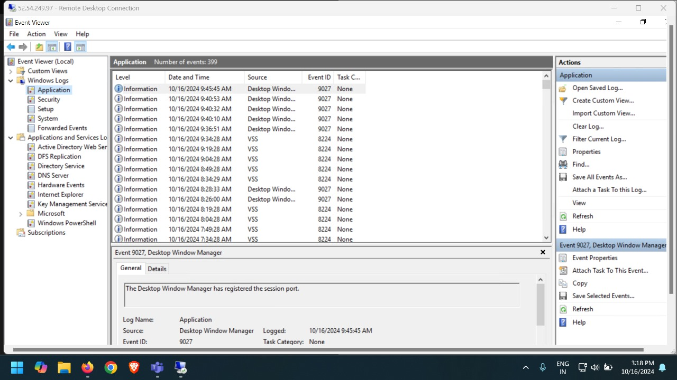
2. Event Viewer: Windows Event Viewer logs critical system and security events, aiding in troubleshooting and ensuring system stability.

Slide 17
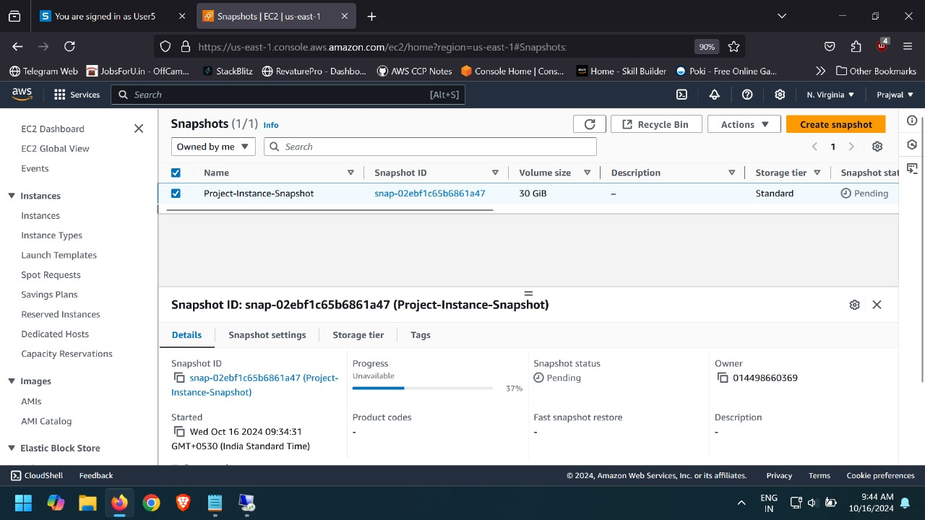
1. EBS Snapshots: EBS snapshots are taken regularly to capture point-in-time backups of EBS volumes attached to EC2 instances. These snapshots provide a quick disaster recovery solution.
BACKUP AND RECOVERY

Slide 18
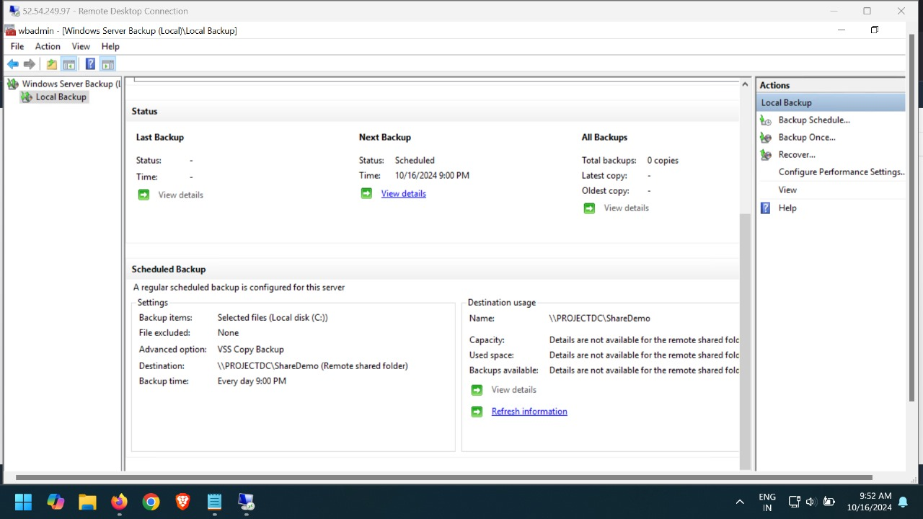
2. Windows Backup: Windows Backup is configured on the server to automate the backup process of critical system files and data, ensuring data integrity in case of failure.

Slide 19
REAL TIME SCENARIO
Scenario 1: A small e-commerce company wants to move its on-premises web application to the cloud to improve scalability and reduce operational costs. The company currently runs its web application on a local server that struggles to handle peak traffic during sales events. They decide to implement Windows Server 2016 on AWS to leverage the cloud's flexibility and reliability.
Outcome: By migrating to AWS, the e-commerce company successfully improved the scalability of its web application, enabling it to handle increased traffic during sales events. The cloud infrastructure provided enhanced security, reliable performance, and cost-effective resource management, ultimately leading to improved customer satisfaction and business growth.

Slide 20
FUTURE SCOPE
1. Migration to Newer Windows Server Versions: Future projects can focus on migrating to more recent versions of Windows Server (e.g., 2019 or 2022), ensuring improved performance, security features, and enhanced cloud integration capabilities.
2. Hybrid Cloud Integration: Expanding the infrastructure to a hybrid cloud model by integrating on-premises systems with AWS, allowing for seamless data exchange, enhanced disaster recovery, and greater flexibility in resource management.
3. Automation and Orchestration: Implementing AWS tools like AWS Systems Manager and CloudFormation to automate server management, patching, scaling, and resource deployment for more efficient operations.
4. Serverless and Containerization Solutions: Exploring the use of AWS Lambda or Docker containers to reduce dependency on virtual machines, enabling faster application deployment, scaling, and maintenance.
5. Advanced Security Features: Leveraging AWS services such as AWS Shield and GuardDuty for enhanced threat detection, DDoS protection, and compliance with stricter security regulations.
6. Enhanced Monitoring and Analytics: Utilizing advanced analytics tools like Amazon Athena and AWS X-Ray to gain deeper insights into system performance, optimize resource utilization, and detect inefficiencies.
7. AI and Machine Learning Integration: Incorporating AWS AI/ML services for predictive monitoring and automated troubleshooting, further reducing manual intervention and increasing operational efficiency.

Slide 21
CONCLUSION
In conclusion, the administration and implementation of Windows Server 2016 within AWS Cloud Infrastructure have demonstrated significant advantages in scalability, security, and efficiency.
By leveraging key features such as Active Directory, DNS, DHCP, and web services, we created a robust environment that effectively meets organizational needs.
The use of backup solutions like AWS AMI and EBS snapshots ensures data integrity and rapid recovery in case of failures.
Additionally, our monitoring tools, including CloudWatch and Windows Performance Monitor, provide real-time insights into system performance, facilitating proactive management.
Overall, this project not only enhances resource management but also establishes a secure foundation for future cloud-based initiatives.

Slide 22
THANK YOU!

